Slide 1


Slide 2
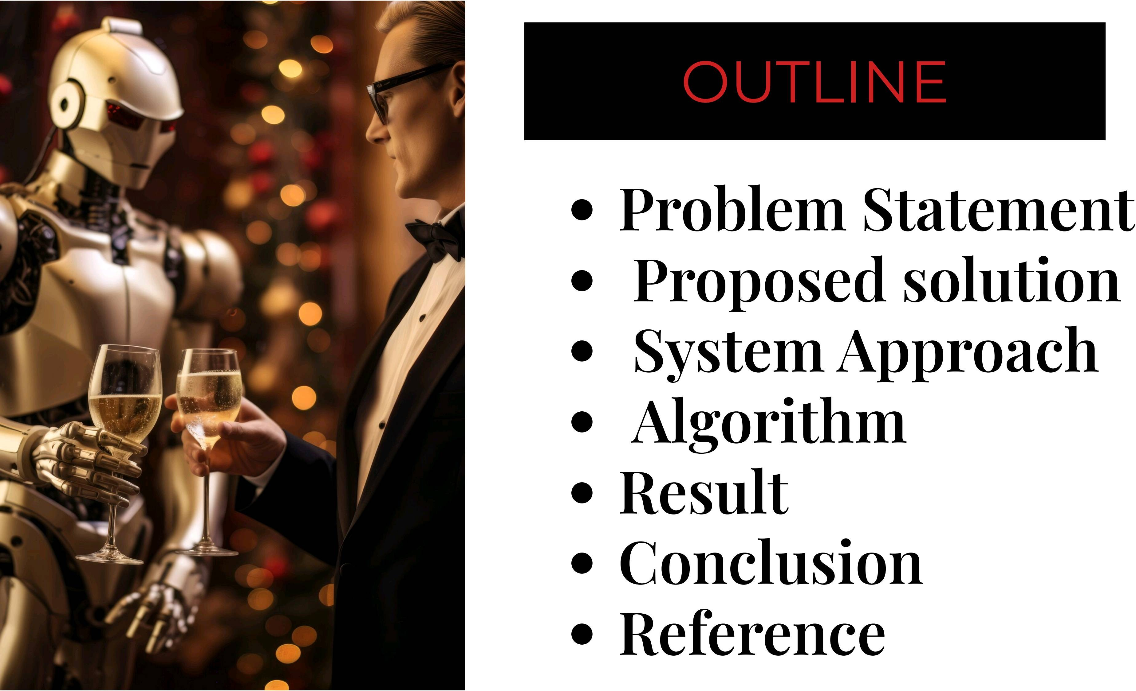

Slide 3
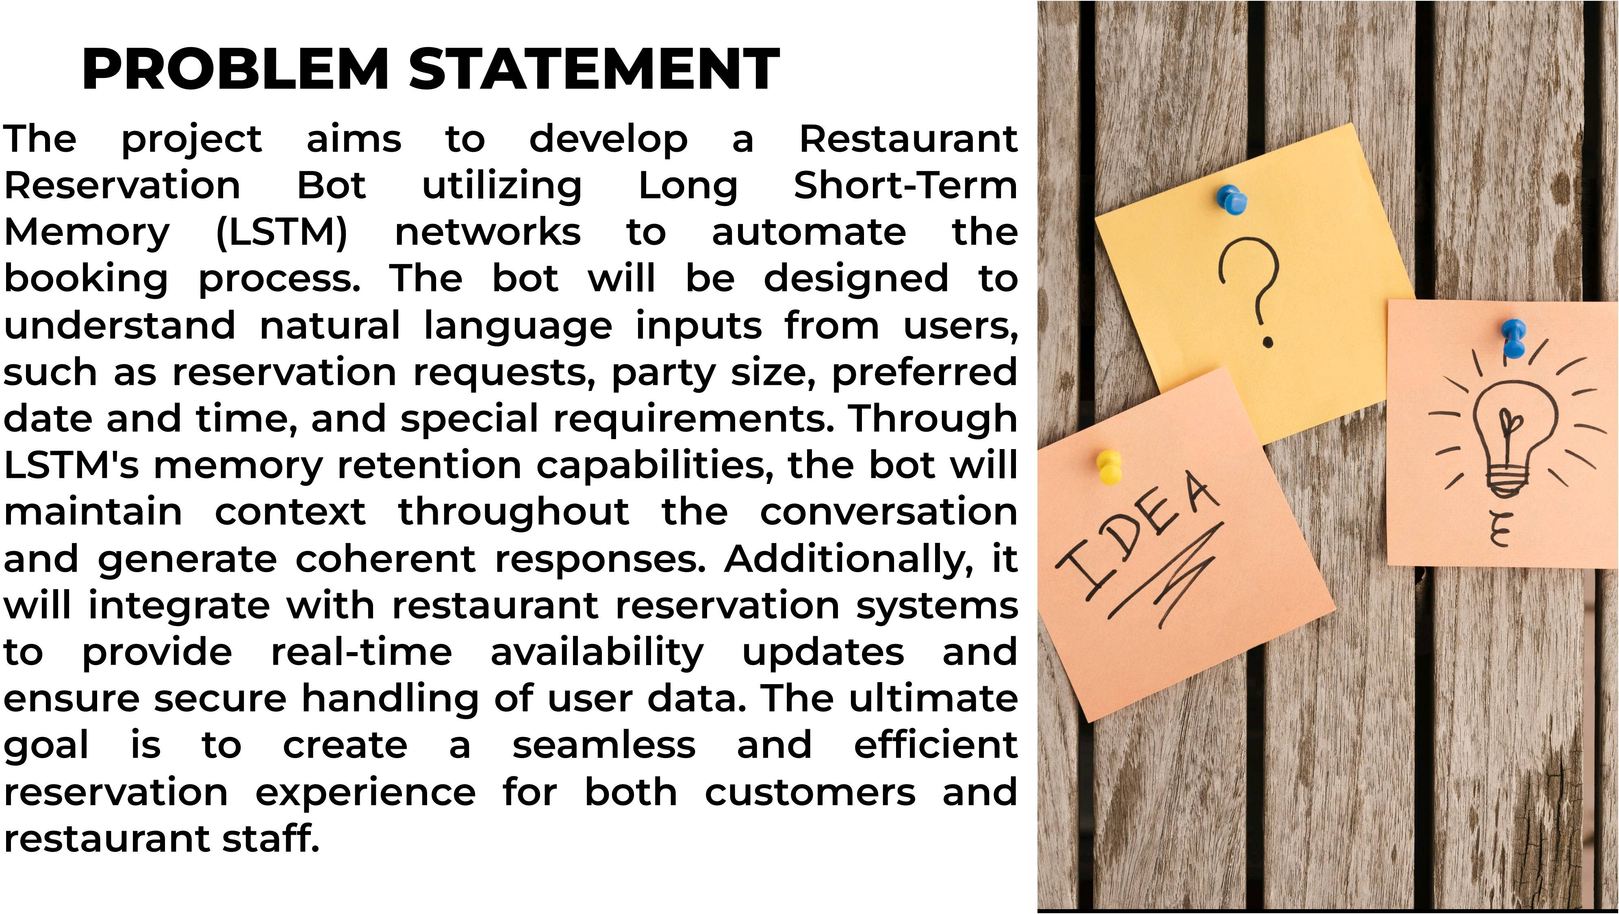

Slide 4
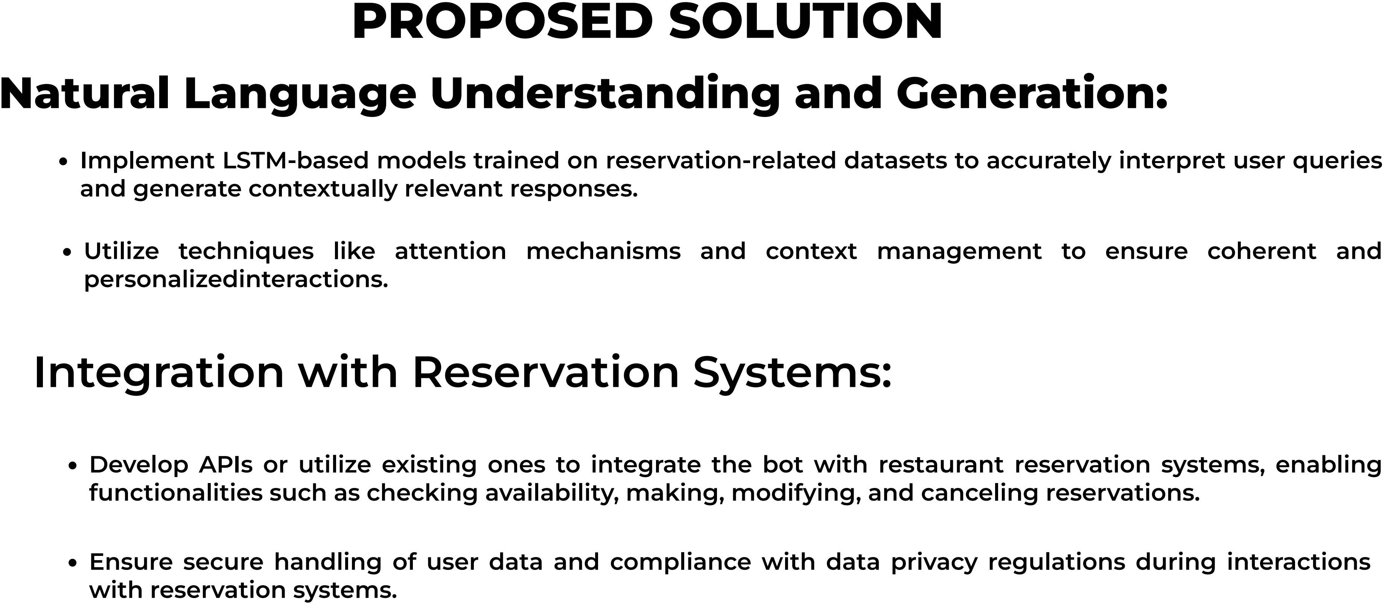

Slide 5
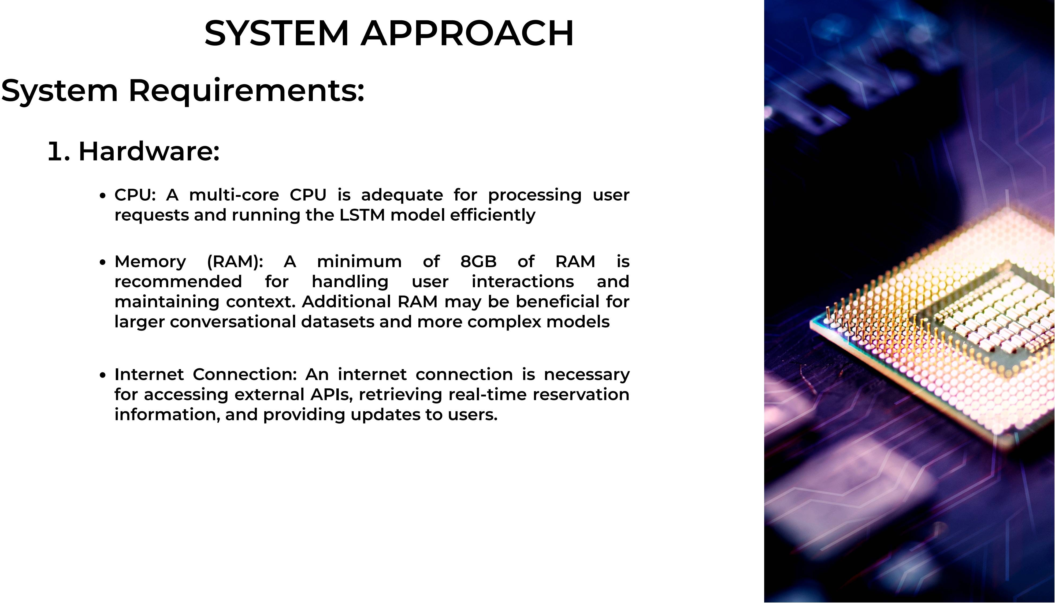

Slide 6
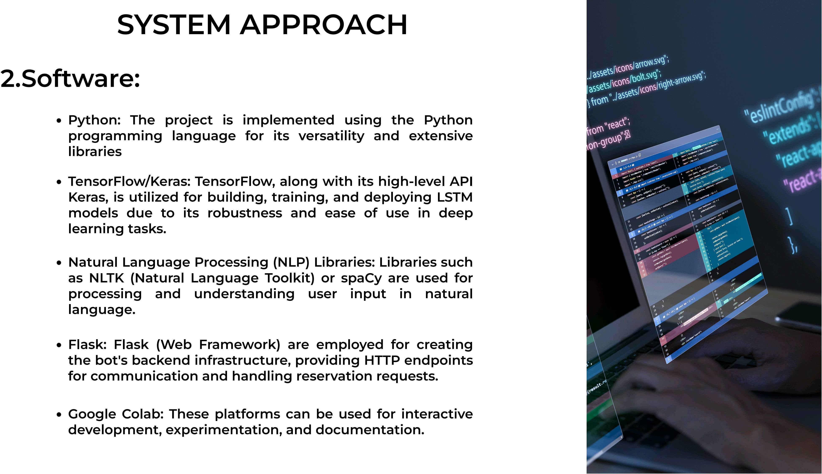

Slide 7
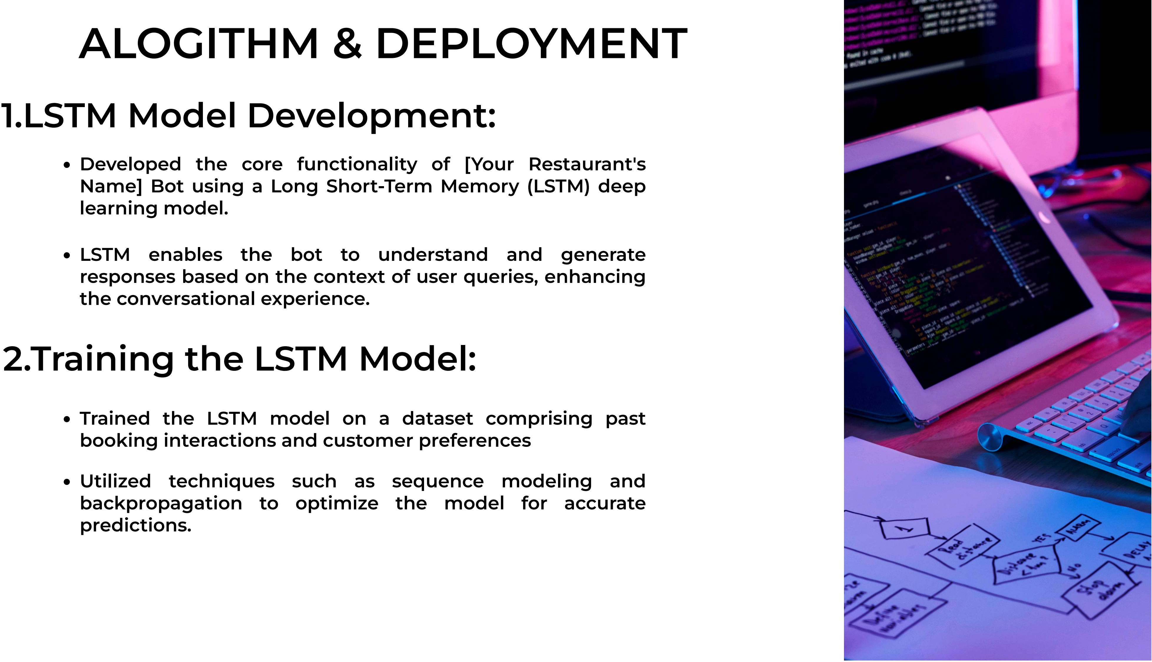

Slide 8
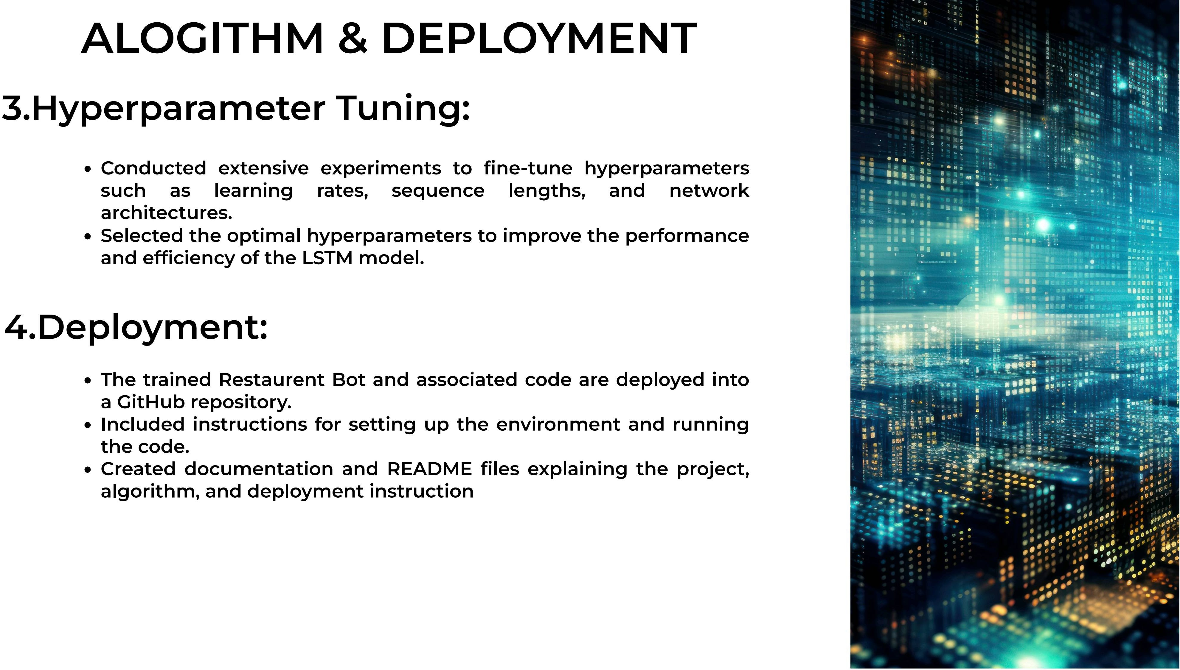

Slide 9
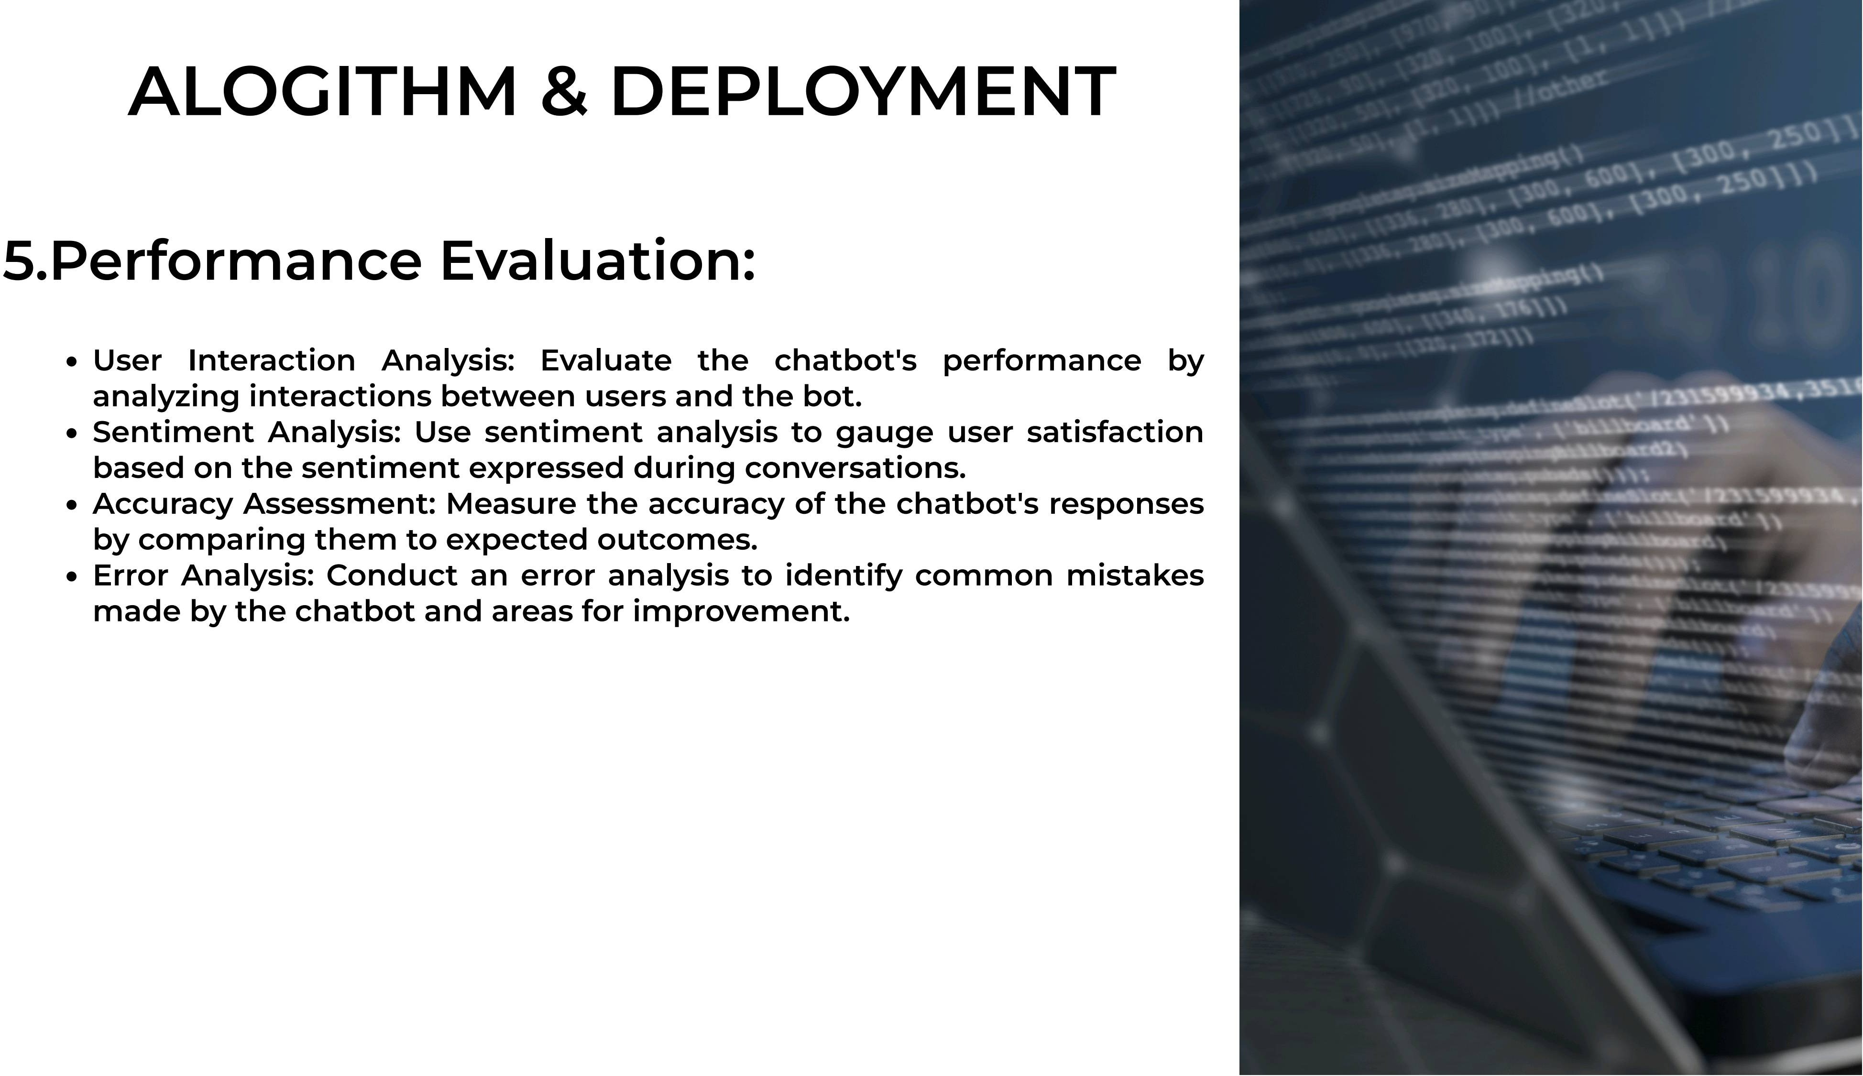

Slide 10
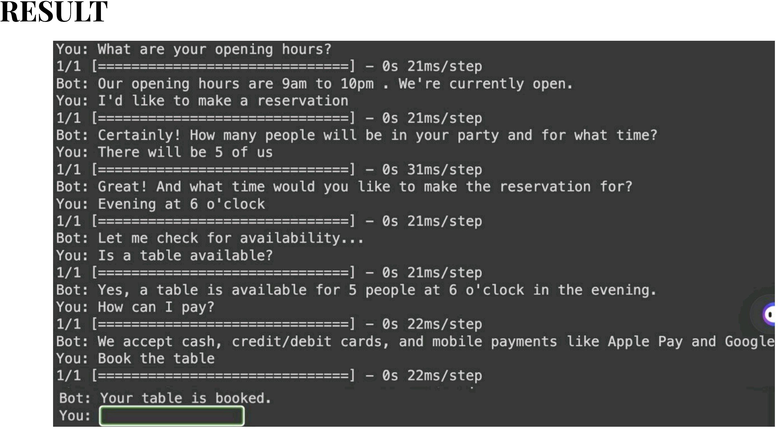

Slide 11
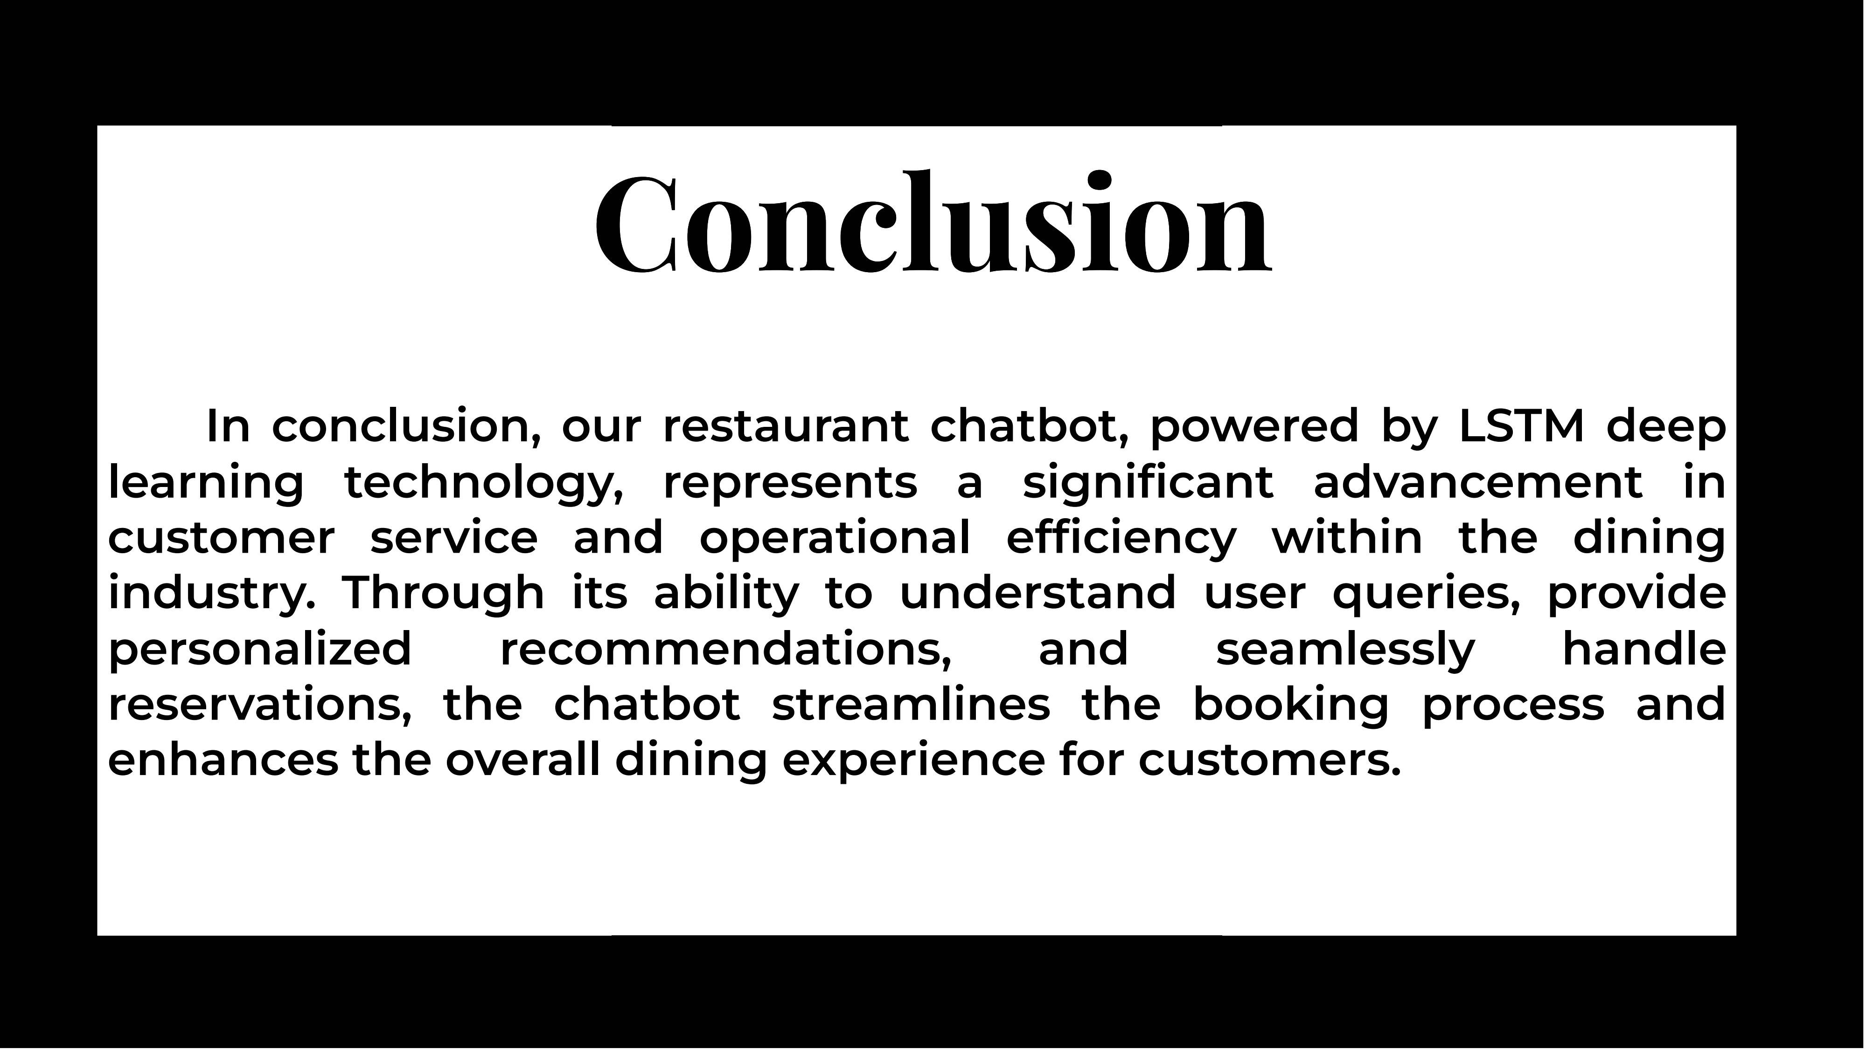

Slide 12
REFERENCES
https://docs.python.org/3/library/json.html https://numpy.org/
https://www.tensorﬂow.org/ https://keras.io/
https://www.tensorﬂow.org/api_docs/python/tf/keras
/preprocessing/text/Tokenizer
https://www.tensorﬂow.org/api_docs/python/tf/keras
/utils/pad_sequences

